Slide 1
SOFTWARE CONFIGURATION MANAGEMENT

Slide 2
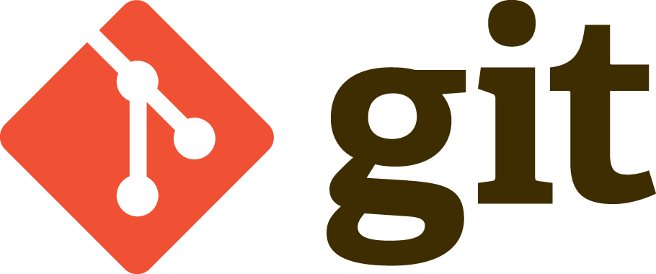
GIT
OVERVIEW
Git is a version control system which enables you to track changes to files. It is entirely file based itself, meaning there is no additional software or applications required except Git itself.
Using Git, you are able to revert files back to previous versions, restore deleted files, remove added files and even track down where a particular line of code was introduced.

Slide 3
GIT
BASIC FUNCTIONALITY
Branching and Merging
Small and Fast
Distributed
Data Assurance
Staging Area
Free and Open Source
Notes:
Branching and Merging
- The Git feature that really makes it stand apart from nearly every other SCM out there is its branching model.
- Git allows and encourages you to have multiple local branches that can be entirely independent of each other. The creation, merging, and deletion of those lines of development takes seconds.
Small and Fast
- Git is fast. With Git, nearly all operations are performed locally, giving it a huge speed advantage on centralized systems that constantly have to communicate with a server somewhere.
Distributed
One of the nicest features of any Distributed SCM, Git included, is that it's distributed. This means that instead of doing a "checkout" of the current tip of the source code, you do a "clone" of the entire repository.
Data Assurance
The data model that Git uses ensures the cryptographic integrity of every bit of your project. Every file and commit is checksummed and retrieved by its checksum when checked back out.
Staging Area
- Unlike the other systems, Git has something called the "staging area" or "index". This is an intermediate area where commits can be formatted and reviewed before completing the commit.
One thing that sets Git apart from other tools is that it's possible to quickly stage some of your files and commit them without committing all of the other modified files in your working directory or having to list them on the command line during the commit.

Slide 4
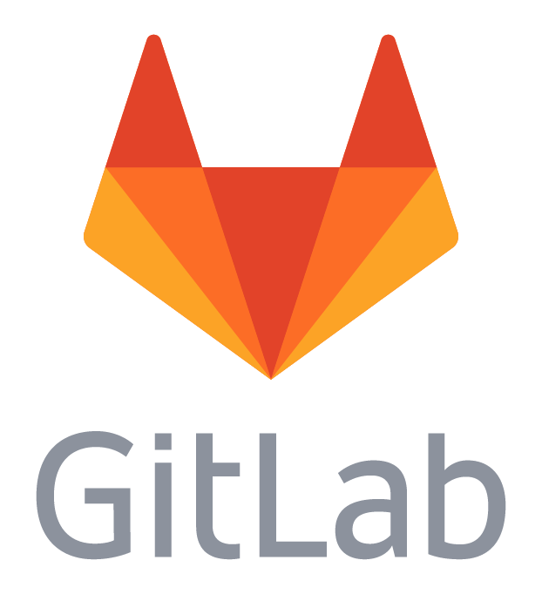
GITLAB
OVERVIEW
GitLab is a Git-based fully featured platform for software development.
It is a web-based repository manager that lets teams collaborate on code, duplicate code to safely create and edit new projects, then merge finished code into existing projects.
Written in the Ruby programming language and includes a Wiki and issue- tracking features.
Copyright © 2017 Accenture All rights reserved.

Slide 5
GITLAB
BASIC FUNCTIONALITY
Projects and Groups
Permissions
GitLab Pages
File Locking
Wiki
Unlimited Public and Private Repos
Project Importing
Protected Branch

Slide 6

GERRIT
OVERVIEW
Gerrit is a web based code review tool which is integrated with Git and built on top of Git version control system (helps developers to work together and maintain the history of their work). It allows to merge changes to Git repository when you are done with the code reviews.
Gerrit was developed by Shawn Pearce at Google which is written in Java, Servlet, GWT(Google Web Toolkit).
Notes:
Git is a version control system which enables you to track changes to files. It is entirely file based itself, meaning there is no additional software or applications required except Git istelf.
Using Git, you are able to revert files back to previous versions, restore deleted files, remove added files and even track down where a particular line of code was introduced.
Git creates a .git folder (in the current folder) to store the details of the file system - this folder contains all the data required to track your files and is known as a repository, or repo.
Git tracks file changes by the user creating a save point, or in Git terms a commit. Each commit takes a snapshot of the current file system rather than storing just the changes made since the last commit. This allows a commit ot be extracted and the whole history not required to rebuild the file system.

Slide 7
GERRIT
BASIC FUNCTIONALITY
Gerrit is a free and an open source Git version control system.
The user interface of Gerrit is formed on Google Web Toolkit.
It is a lightweight framework for reviewing every commit.
Gerrit acts as a repository, which allows pushing the code and creates the review for your commit.
Gerrit provides access control for Git repositories and web frontend for code review.
You can push the code without using additional command line tools.
Gerrit can allow or decline the permission on the repository level and down to the branch level.
Gerrit is supported by Eclipse.

Slide 8
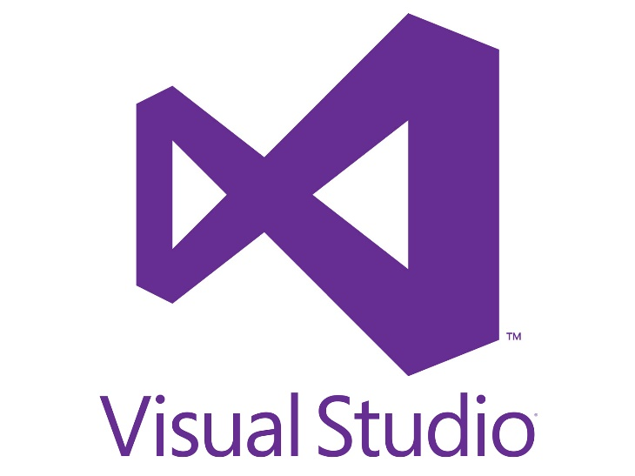
VIRTUAL STUDIO
OVERVIEW
Visual Studio is a complete set of development tools for building ASP.NET Web applications, XML Web Services, desktop applications, and mobile applications. Visual Basic, Visual C#, and Visual C++ all use the same integrated development environment (IDE), which enables tool sharing and eases the creation of mixed-language solutions. In addition, these languages use the functionality of the .NET Framework, which provides access to key technologies that simplify the development of ASP Web applications and XML Web Services.
Visual Studio comes with a code editor that supports IntelliSense (the code completion component) as well as code refactoring. On top of that, the system also has built-in tools such as a forms designer for building GUI applications, web designer, class designer, and database schema designer.

Slide 9
VIRTUAL STUDIO
BASIC FUNCTIONALITY
Project collaboration
Task management
Create permissions
Manage users
Customize dashboard
Create reports
Export to Excel
Java, Ruby, Python etc.
Obtain software insights
Identifies bugs
Hosting included
Freemium version
Online support
Video tutorials
View backlogs
Eclipse plugin
Git client support
Scalable packages
Upgrade/downgrade pricing
Web-based

Slide 10
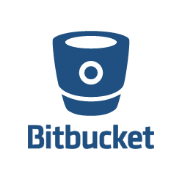
BIT BUCKET
OVERVIEW
Bitbucket is a web-based hosting solution for projects that use either the Mercurial or Git revision control systems. Developed for professional teams, BitBucket enables users to code, manage, and collaborate on Git projects.
BitBucket provides tons of benefits for professional developers and code workers. It comes with a distributed control system that allows easy collaboration and massive scaling. It can be deployed according to the needs and sizes of teams and users have the option to host it on their servers or in the cloud. BitBucket also boasts unlimited private and public repositories.

Slide 11
BIT BUCKET
BASIC FUNCTIONALITY
Git repository hosting
Pull requests
Inline discussions
Branch permissions
JIRA software integration
Projects
APIs
3rd party integrations
Git large file support
Clustering
Smart mirroring
Mercurial repository hosting
Snippets
Issue tracking
Wiki

Slide 12

Questions
For Internal Use Only

